Slide 1
USB 2.0 Specification
General specifications
Length | 5 metres (maximum)
Width | 11.5 mm (A-plug), 8.45 mm (B-plug),
Height | 4.5 mm (A-plug), 7.78 mm (B-plug, pre-v3.0)
Hot pluggable | Yes
External | Yes
Cable | 4 wires (or 8 wires in USB 3.0 version)
Pins | 4 (or 8 in USB 3.0 version) (1 supply, 2 data, 1 ground) (plus additional 4 for SuperSpeed technology in USB 3.0 version)
Connector | Unique
Electrical
Signal | 5 volt DC
Max. voltage | 5 V(±5%)
Max. current | 500–900 mA @ 5 V (depending on version)
Data
Data signal | Packet data, defined by specifications
Width | 1 bit
Bitrate | 1.5/12/480/4,000 Mbit/s (depending on version)
Max. devices | 127
Protocol | Serial
Transaction types.
Type | Attributes | Maximum Size | Example
Interrupt | Quality | 64 bytes | Mouse, Keyboard
Bulk | Quality | 64 bytes | Printer, scanner
Isochronous | Time | 1024 bytes | Speakers, Video
Control | Time and Quality | 64 bytes | System control

Slide 2
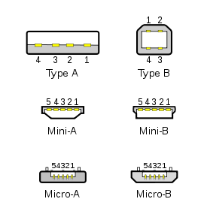
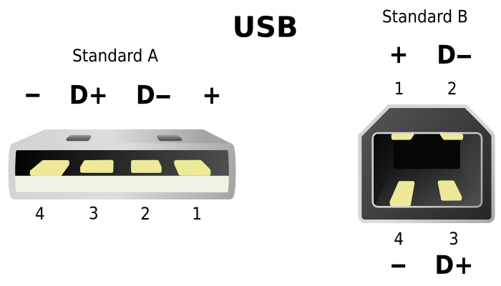
USB Connector Styles
USB 1.x/2.0 Mini/Micro pinout
Pin | Name | Cable color | Description
1 | VBUS | Red | +5 V
2 | D− | White | Data −
3 | D+ | Green | Data +
4 | ID | None | Permits distinction of A plug from B plug
 |  |  | * A plug: connected to Signal ground
 |  |  | * B plug: not connected
5 | GND | Black | Signal ground
USB 1.x/2.0 standard pinout
Pin | Name | Cable color | Description
1 | VBUS | Red | +5 V
2 | D− | White | Data −
3 | D+ | Green | Data +
4 | GND | Black | Ground

Slide 3
USB Cable/Wiring Interface
Type | Attributes | Maximum Size | Example
Interrupt | Quality | 64 bytes | Mouse, Keyboard
Bulk | Quality | 64 bytes | Printer, scanner
Isochronous | Time | 1024 bytes | Speakers, Video
Control | Time and Quality | 64 bytes | System control

Slide 4
Differential Signaling

Slide 5
Fundamental USB Packet

Slide 6
USB Overcurrent Protection for SSS-903
Design requirements.
Design must operate within the -40°C to +85°C temperature range.
SSS-903 must supply the USB buss with 5 volts (3.3 volts if the memory stick will operate with this voltage).
The hardware design must be compatible with the USB 2.0 standard.
Hardware design must provide overcurrent and overvoltage protection for the 5 volt
supply voltage rail.
Hardware design must provide overvoltage protection to the USB data signals. (D+ and D-)
Connector must support HART and USB.
Connector must be IPV66 better or compatible.

Slide 7
Key USB VBus Protector Manufacturers
National Semiconductor (One device)
Maxim IC (Several)
Linear Technology (Two devices)
ON Semiconductor (Includes data line TVS overvoltage protection)
TI (Several)

Slide 8
Over Voltage Circuit Manufacturers
Semtech
Little Fuse

Slide 9
Available parts
$0.69 each at 1K+ pcs National
1,000: $0.647 On Semi
$1.15 each at 1K+ pcs Maxim
1,000: $1.94 Linear
T.I. ?

Slide 10
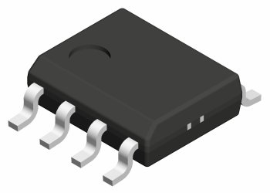
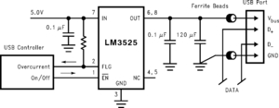
National LM3525

Slide 11
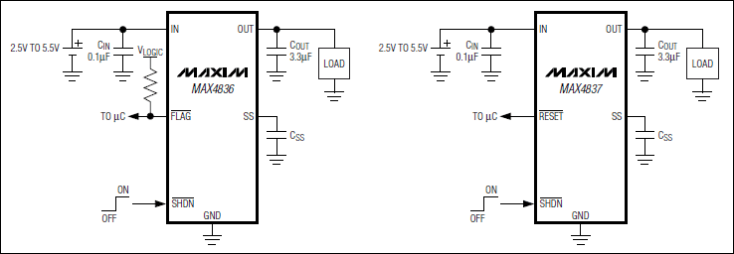
Maxim 483x

Slide 12
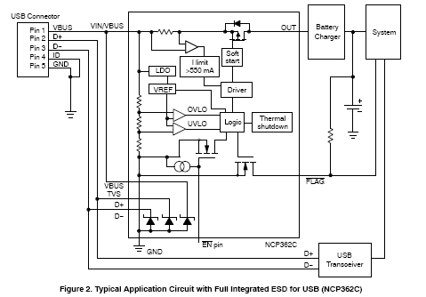
On Semiconductor NCP362C

Slide 13
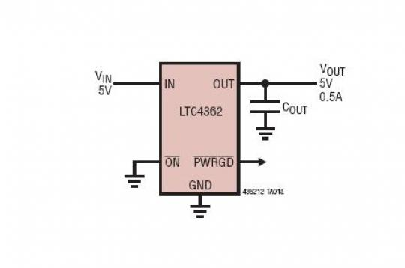
Linear LTC4362

Slide 14
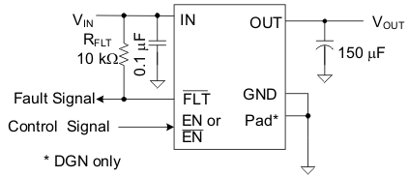
TI TPS20xxC Family
Typical Application Diagram

Slide 15
Little Fuse Minimalist Approach

Slide 16
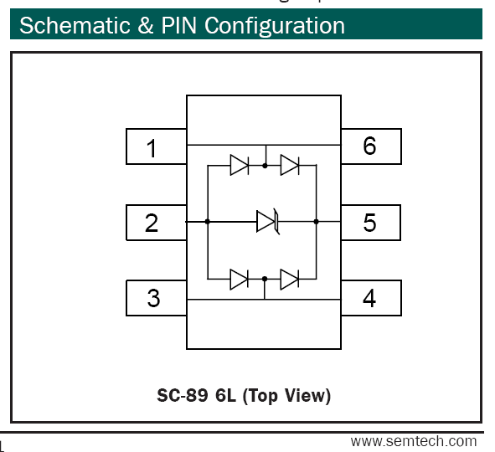
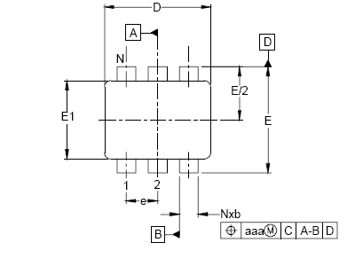
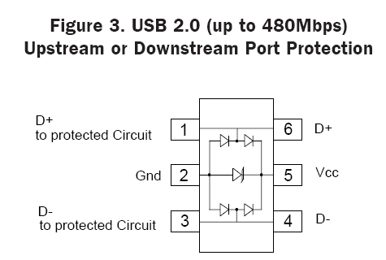
Semitech TVS Protection for USB 2.0
Features
Bidirectional EMI/RFI filtering and line termination with integrated ESD protection
ESD protection for USB power (V_{BUS}) and data lines (D+ and D-) to
IEC 61000-4-2 (ESD) ± 15 kV (air), ± 8 kV (contact)
IEC 61000-4-4 (EFT) 40 A (5/50 ns)
Filtering and termination for one USB port
Low TVS operating voltage: 5.25 V
Low leakage current
Small SC70-6L package
Solid-state technology

Slide 17
Weather Proof connectors.
http://www.usbfirewire.com/usb-rugged-waterproof.html
Kris Merrifield
Direct: 586-913-8633
Toll Free: 1-800-394-7732
Email: kmerrifield@sineco.com
+

Slide 18
References
http://www.national.com/mpf/LM/LM3526.html#Overview
http://www.maxim-ic.com/datasheet/index.mvp/id/4376
https://shop.maxim-ic.com/storefront/priceavailable.do?event=PartSearch&menuitem=PriceAndAvailability&Partnumber=MAX4836
http://www.onsemi.com/PowerSolutions/search.do?query=NCP362C&tabbed=Y&clearFilters=Y&searchType=others
http://circuits.linear.com/498
http://search.digikey.com/scripts/DkSearch/dksus.dll?Detail&name=LTC4362CDCB-2%23TRMPBFTR-ND
http://www.ti.com/corp/docs/landing/usb-power/index.htm
http://focus.ti.com/paramsearch/docs/parametricsearch.tsp?family=analog&familyId=667&uiTemplateId=NODE_STRY_PGE_T
http://www.semtech.com/selector/index.html?ver=TVS&id=USB 1.1 2.0 OTG
http://en.wikipedia.org/wiki/USB

Slide 19
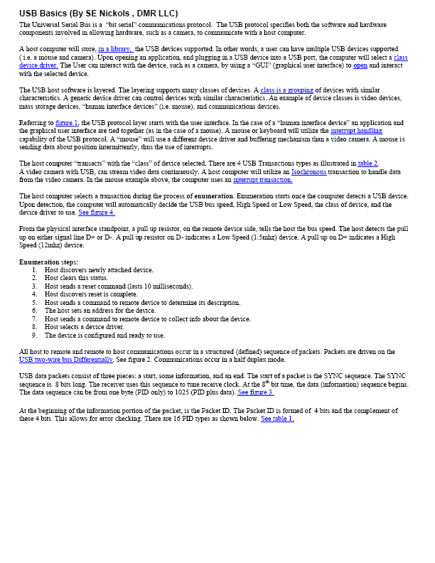
USB Basics

